Slide 1
Build Innovation
Capabilities That Drive Growth
PJ Mason | Innovation Consulting
Former P&G Senior Director • 20+ Years

Slide 2
The Challenge
Mid-market companies know innovation is critical.
But building world-class capabilities from scratch?
That's a different challenge entirely.
•Most consultants only advise — they don't build
•Agencies are expensive and don't transfer knowledge
•You need someone who's actually done it before

Slide 3
Proven Track Record
$100M+
14 Years
Revenue Impact
P&G Senior Director
Platforms led at P&G
Oral Care & Smart Products
16
8+
Design Teams Led
Major Awards
Across 3 continents
German Design, iF, Red Dot

Slide 4
What I've Actually Built
Built P&G's First Digital Design Capability
From external dependencies to fully internalized world-class team
Team Building
Process Design
Results Delivery
Recruited, developed, and retained top design talent across regions
Established design thinking methodology and portfolio management systems
Led award-winning platforms generating hundreds of millions in growth
Now I help mid-market companies ($100M-$1B) build the same capabilities

Slide 5
How I Can Help
Innovation Capability Assessment
Design Capability Build
Build functioning design capability from scratch — team structure, processes, recruiting, pilot projects
Comprehensive audit of current processes, portfolio, and team structure with benchmarked recommendations
6-12 months • $150-300K
4-6 weeks • $25-40K
Innovation Platform Development
Fractional Chief Design Officer
Lead multi-functional teams to develop new product platforms from vision to market
Strategic design leadership on retainer — portfolio reviews, team mentoring, key initiatives
12-18 months • $300-500K+
Ongoing • $10-20K/month

Slide 6
Proven Results
$55M
50%
30%
Cost Savings
Faster
Reduction
Year-on-Year
Time-to-Market Reduction
Portfolio Complexity
Award-Winning Product Leadership
German Design Award Gold • iF Design Award • Red Dot Award • CES Innovation Award • Good Design Award • Cannes Lion Bronze

Slide 7
My Approach
1
2
3
4
Assess
Design
Build
Scale
Deep dive into current state, processes, portfolio, and opportunities
Create tailored operating model, team structure, and roadmap
Recruit talent, establish processes, run pilot projects
Hand off to internal leadership with sustainable systems
Proven methodology for building capabilities that deliver results
Strategic vision combined with hands-on execution — not just recommendations

Slide 8
Case Study: Oral-B iO Platform
Challenge
Re-platform P&G's Oral Care with first-ever IoT-connected toothbrush
My Role
Results
•Led design strategy and vision
•$100M+ revenue platform
•Built digital design team
•German Design Award Gold
•Managed innovation delivery
•iF, Red Dot, CES awards
Transformational capability building for companies

Slide 9
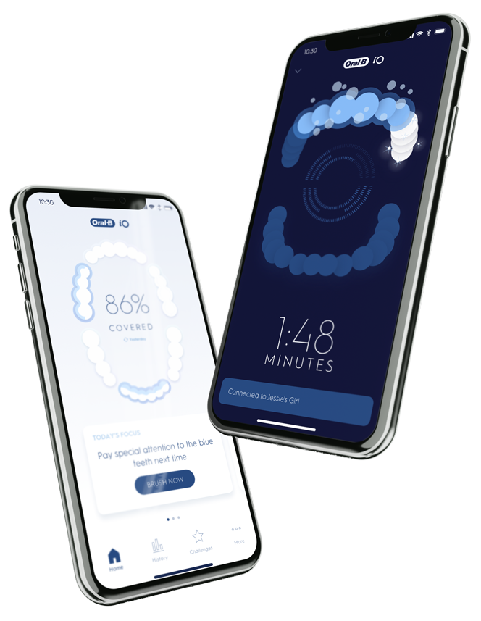

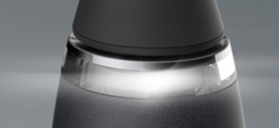
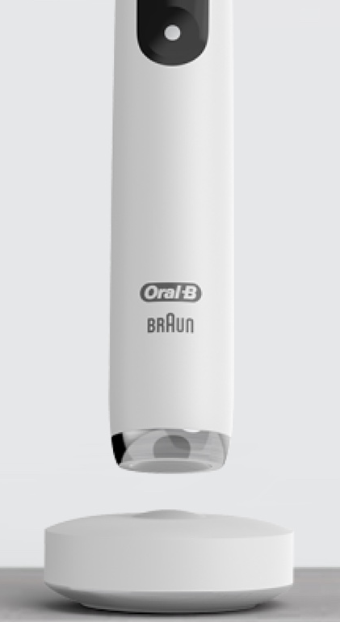
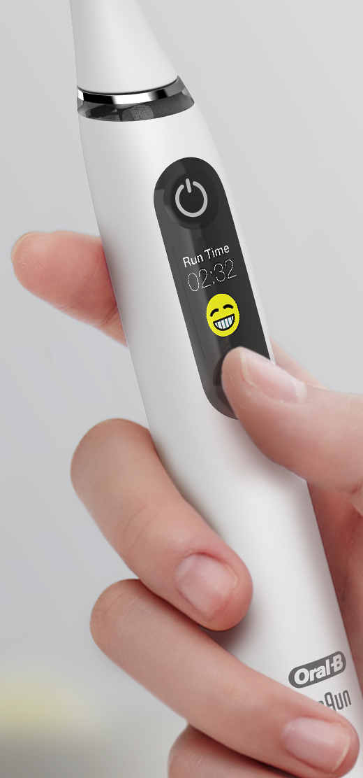
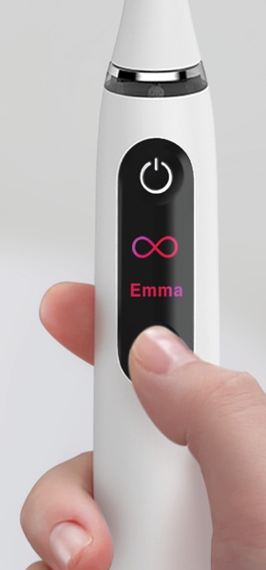

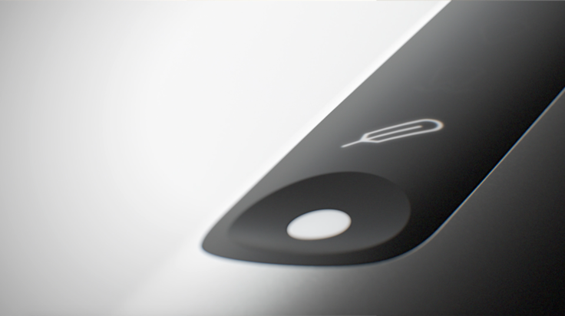
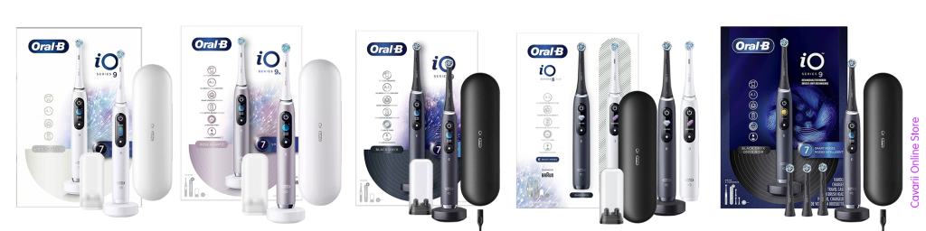

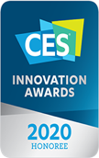


Object of Desire
Connect emotionally

Slide 10
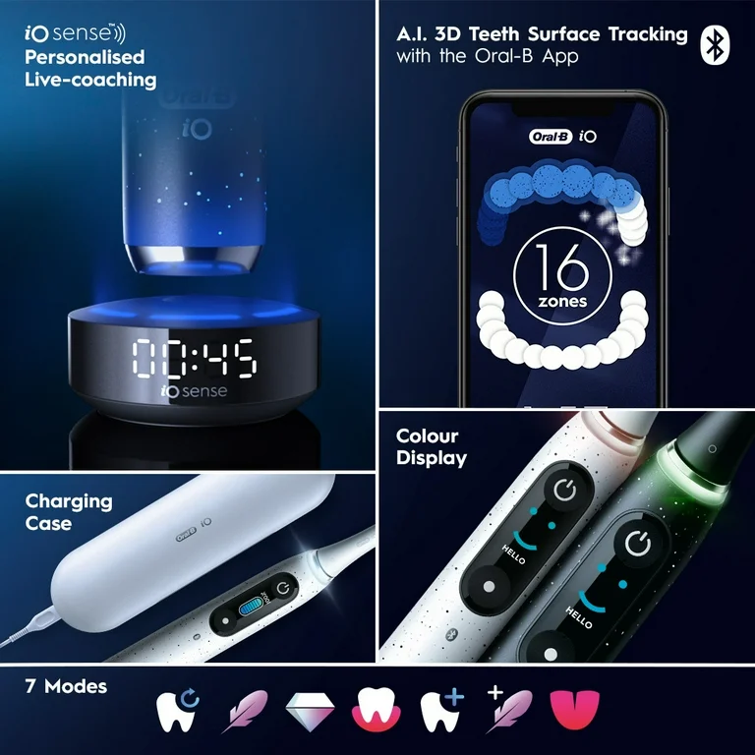
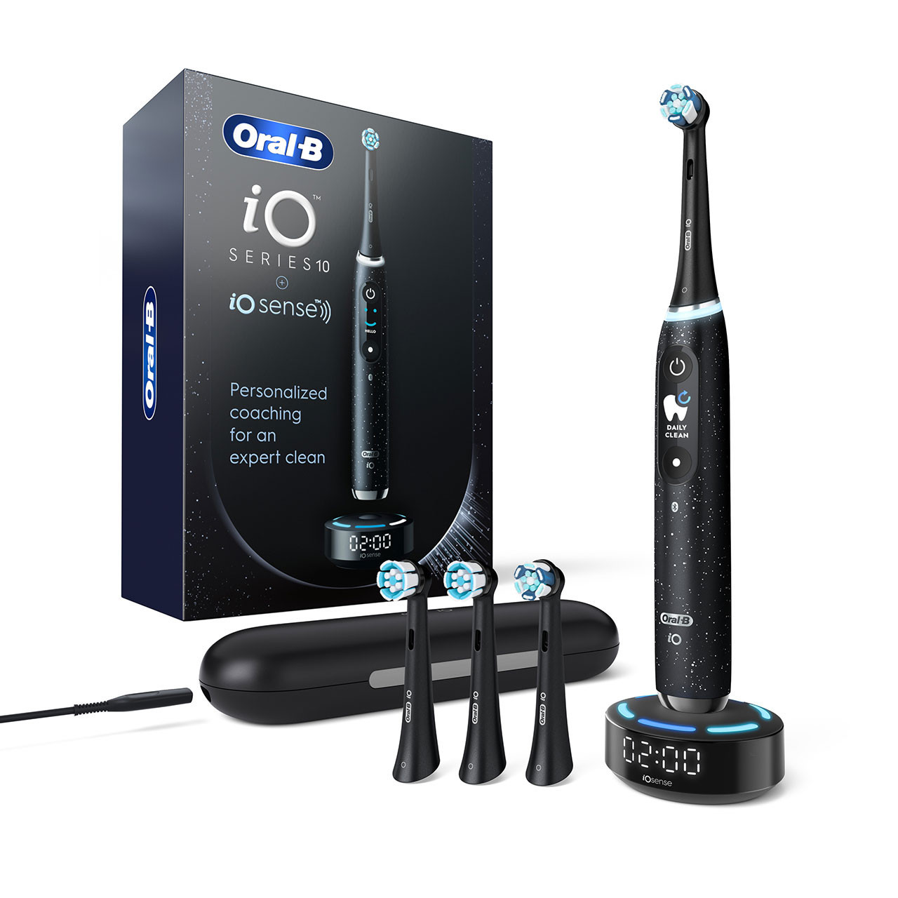

Slide 11
What Makes This Different
Most consultants tell you what to do.
I've actually built it.
Built from Scratch
Global Leadership
Strategic + Hands-On
P&G Digital Design Capability
16 teams, 3 continents
C-suite vision, execution
Proven Results
Design Thinking
Talent Development
$100M+ impact, awards
C-suite facilitation
Recruit, develop, retain

Slide 12
Ready to Build
World-Class Innovation?
Let's discuss how I can help your company
PJ Mason
pjmason1220@gmail.com
513-282-8775
S. Lebanon, Ohio

